Slide 1

Don’t Lose the Future: Latent-Aware Vector Quantization
Raymond
College of Computing and Data Science (CCDS)
4 November 2026
Notes:
2026年10月28日组会。汇报当前Q0、部署与跨模型闭环证据，以及面向nativeINT8的定位和实验计划。
数据截止2026-10-27。
证据来源（本地）：

Slide 2
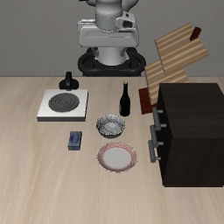
future degradation drives action error
observation
video
predicted future
action
action error
BF16
(reference)
video
action
2-bit
VQ
video
action
swap in BF16 future
−73%
2-bit VQ
+ BF16
future
video
action
Restoring the future removes 73% of action error
BF16 weights
2-bit weights
degraded future
restored future
Figure 1. Under 2-bit vector quantization, a WAM’s predicted fu-ture degrades, and most of its action error follows from it: swap-ping in the full-precision future removes 73% of the action error(Fast-WAM, QTIP).
Notes:
Editable reconstruction of figure1_lavq_imagegen_v2.png. All lettering, panel backgrounds, matrices/cells, latent-frame stacks, hatching, gripper outlines, contours, arrows, reference lines and annotations are editable native PowerPoint elements. The 3 observation images are separate embedded, replaceable/croppable photos. The module-bpw and closed-loop plots are native PowerPoint charts with literal-data workbooks.
Sources: D:/Downloads/Final Year Project/CVPR2027/sec/3_motivation.tex; sec/4_method.tex; sec/5_experiments.tex; sec/X_suppl.tex. Visual reference: CVPR2027/figures/figure1_lavq_imagegen_v2.png. Photo: research/paper/figures-ref/fig1_prompt_refs/06_libero_observation.png.
73%: Fast-WAM 2-bit QTIP future-swap intervention, error 1.00 to 0.27. action rank 41.5 rounded to about 42, dimension 37,632. Future-latent grids and action contours are conceptual schematics, not real decoded predictions or measured spatial heat maps. Bit values QTIP video/action 2.01/2.03, LAVQ 2.22/1.03, both total 1.99 bpw. Success order GPTVQ/QuIP#/QTIP/LAVQ: Fast-WAM 71.7/72.5/73.3/74.6, BF16 77.6; Cosmos-Policy 72.6/77.3/79.9/80.5, BF16 83.5. No significance claims.
Export the slide to PDF for vector lines/text; the three photographs necessarily retain raster image data. Use Selection Pane names to find individual components.
Visual refinement reference: Zhang et al., Revisiting the Domain Shift and Sample Uncertainty in Multi-source Active Domain Transfer, arXiv:2311.12905, Figure 2 (https://arxiv.org/pdf/2311.12905). Borrowed the restrained short drop shadows, layered planar shapes, Arial heading hierarchy and italic mathematical notation; no original figure artwork copied. All new assets are native editable PowerPoint paths and text. The success/failure gripper variants in the icon key are conceptual illustrations, not measured outcomes for the fixed-input future-swap rows. The fixed-input diagnostic and all chart data retain the user's existing values.

Slide 3


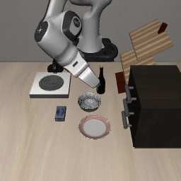
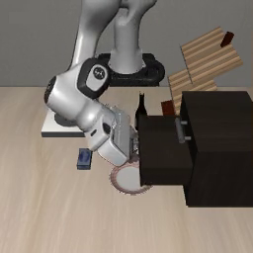
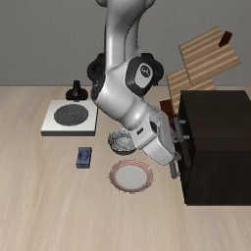
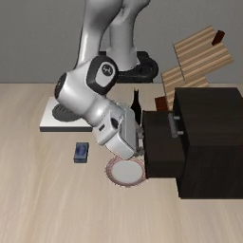
Figure 2. Overview of LAVQ.
LAVQ
Forward / workflow
Reference
Metric / guidance
Table update
Frozen (fixed reference)
Calibrated lookup table (editable)
1
Reader metric
2
Future-aware bit allocation
3
Trellis-coded initialization
Full-precision
future z*
Action
Fixed total bit budget
Future-fidelity
gain / added bit
bₗ
Trellis (common code family)
π(a
*
| z
*
)
…
R*
Future-generating
groups
…
+1 bit
Wₗ
Shared table C
Ŵₗ
…
Δg₁ ↓
Rademacher probes
Δg = 0
groups
…
−1 bit
Δg₂ ↓
…
(Jacobian-vector backpropagation)
Other
layers
…
…
t₁
t₂
t₃
t₄
Reader-aware metric M
Codes cₗ
0
1
0
1
1
0
…
M = 𝔼[Jᵀ D J]
≈
…
+
∑
n
b
≤ B ∑
n
Mixed bit widths {b_{l}}
Low-rank + diagonal + identity
…
l
l
l
l
l
1
2
3
4
1–4 bits · one code family
Fixed codes
Shared tables
Initialize student
4
Shared-table calibration
Deployment
Full-precision WAM (teacher)
Frozen-reader consistency K
Codes + scales + calibrated tables
Calibration contexts (o, ℓ)
z*
a*
…
“open the drawer”
G*
R*
…
π(R*(z*))
0
1
0
1
z*
C_{g} ← C + ΔC_{g}
Future error Z_{M}
R*
π(R*(ẑ))
KL
Z_{M} =
δz^{T} M δz
Action error A
ẑ
L = A + λ_{M}Z_{M} + βK
Standard trellis decoder
||z*||²
K = KL(π(R*(z*)) || π(R*(ẑ)))
Export
δz = ẑ − z*
Quantized WAM (student)
Quantized WAM
Ĝ
ẑ
â
ẑ
â
R̂
…
Ĝ
R̂
…
Codes fixed
C_{g} = C + ΔC_{g}
Shared by
role / bit width
Update shared tables
0
1
0
1
1
0
…
Same bit budget
No extra storage
Notes:
Figure 2: LAVQ. Layout and content faithfully reconstructed from D:/Downloads/Final Year Project/CVPR2027/figures/figure2_lavq_method.png. All text, matrices, trellis, tensors, icons and lines are editable native PowerPoint objects. The only raster source is the user-provided D:/Downloads/Final Year Project/CVPR2027/figures/libero_sim_screenshot.png, reused as requested for the left context and right deployment illustrations. Repeated screenshot thumbnails are illustrative, not new experimental trajectory frames. Method content source: CVPR2027/sec/3_motivation.tex and sec/4_method.tex. The role of scales during calibration remains unspecified in the manuscript; the diagram fixes codes and highlights shared-table calibration.

Slide 4
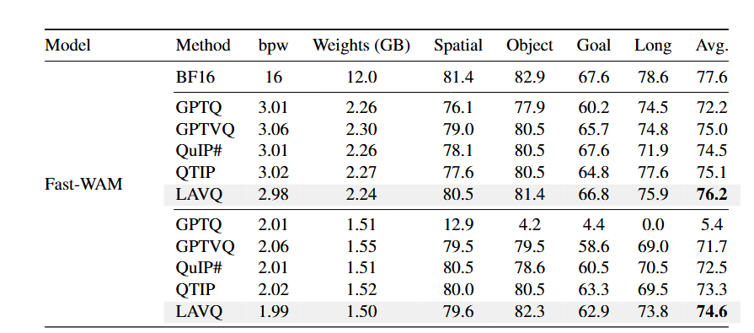
Fast-WAM LIBERO-Plus results

Slide 5
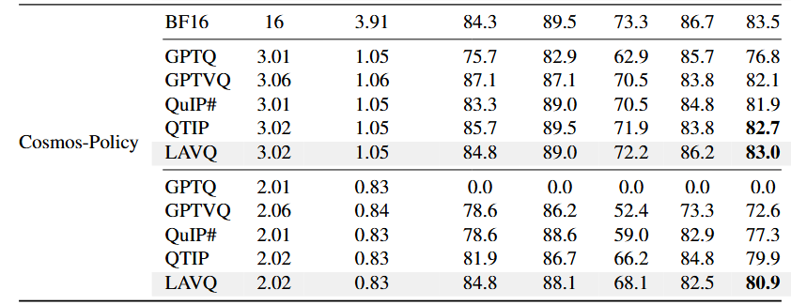
Cosmos Policy LIBERO-Plus results

Slide 6
Need to do:
Ablation
Component ablation. Loss ablation. Bits allocation ablation
Real world
Two-object pick-and-place, Pouring, Cloth folding
Supplementary Material
?

